Slide 1
Shock Tube Simulation Using the Rusanov Numerical Method
Nolan Chanda
Jack Galt
Jimmy Pare

Slide 2
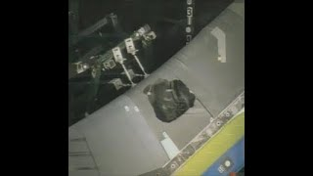
Space Shuttle Columbia Disaster 2003
https://www.youtube.com/watch?v=F-zUswydGXw
Notes:
Jimmy
Collision occurred 82 seconds after launch, roughly 66,000 ft up. Shuttle was moving at Mach 2.5
On february 1st 2003, the space shuttle Columbia had a foam insulating panel pop off during launch. NASA needed to know: would this inhibit re-entry?
Of 74 space shuttle launches with imagery, foam released and struck the spacecraft on 65.

Slide 3
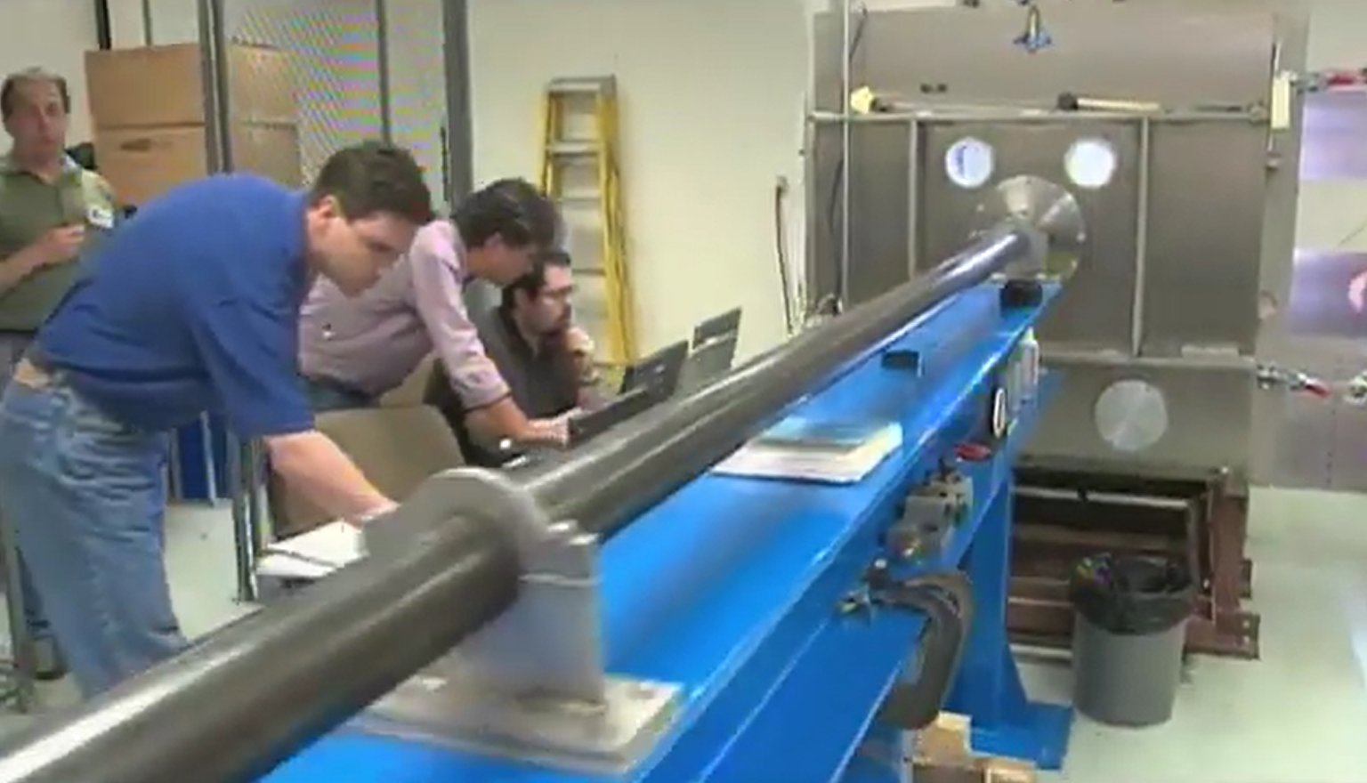
A shock tube was used to simulate this incident.
https://www.youtube.com/watch?v=F-zUswydGXw
Notes:
Jimmy

Slide 4
A scaled up model showed this:
But what pressure ratio was required within the shock tube?
https://www.youtube.com/watch?v=F-zUswydGXw
Notes:
Jimmy
Foam was moving about 545 mph relative to spacecraft, or mach .8 at 70,000 ft

Slide 5
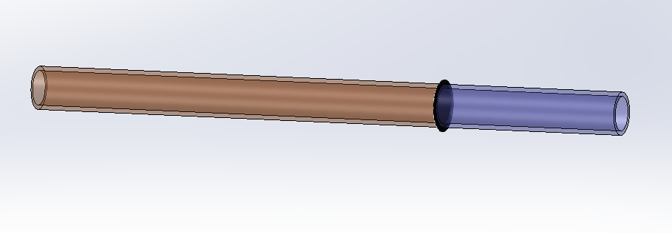
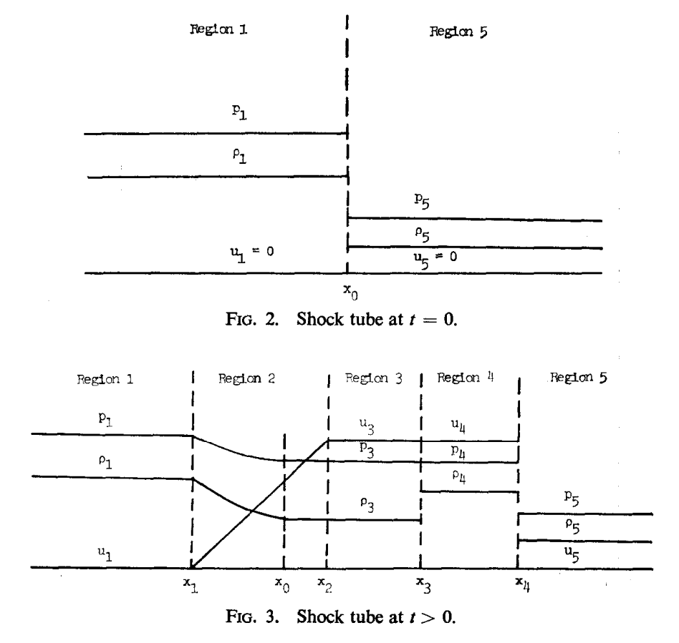
The simulated problem: a shock tube
High Pressure
“Driver”
Low Pressure
“Driven”
Notes:
Nolan

Slide 6
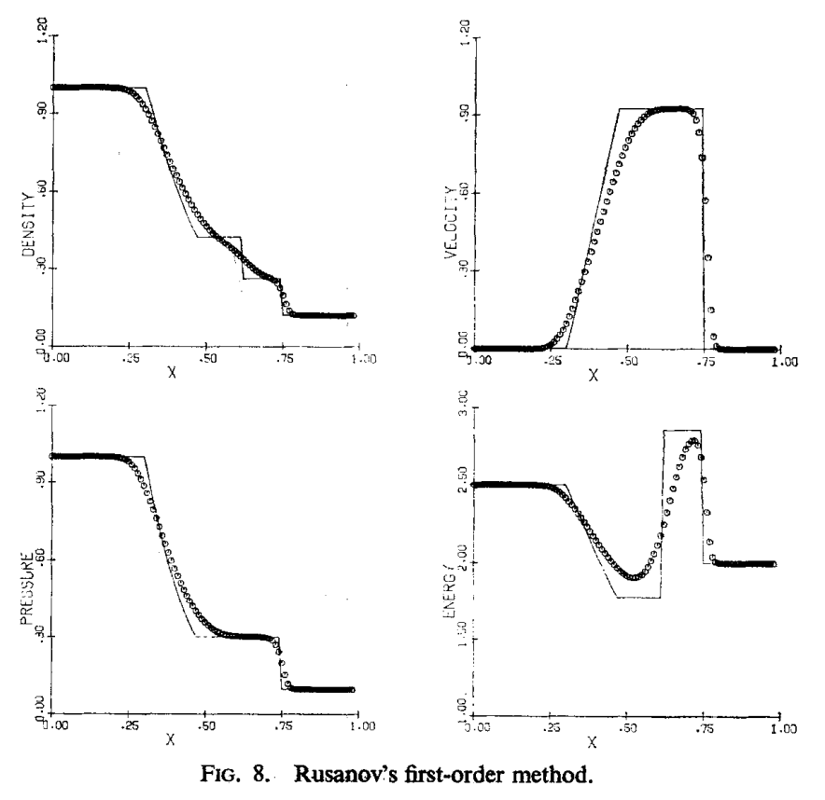
Paper: “A Survey of Several Finite Difference Methods for Systems
of Nonlinear Hyperbolic Conservation Laws” by Gary A. Sod
Sod compares several different numerical methods.
Methods are compared by simulating a shock tube flow.
We focus on simulating the Rusanov numerical method.
Notes:
Nolan

Slide 7
The simulated problem: a shock tube
Notes:
Nolan

Slide 8
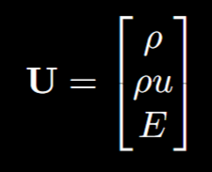
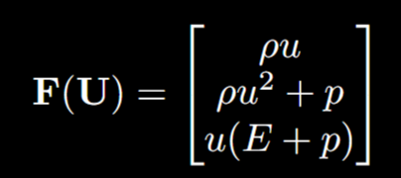
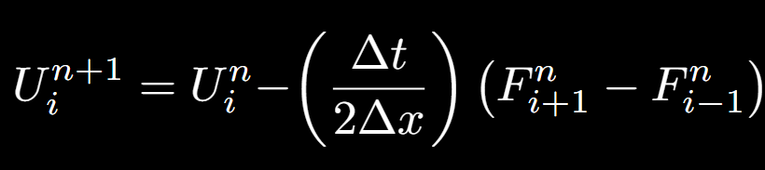
Rusanov Method Overview
Notes:
Nolan

Slide 9
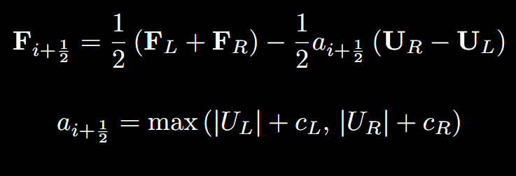
Rusanov Method Overview
Notes:
Nolan

Slide 10
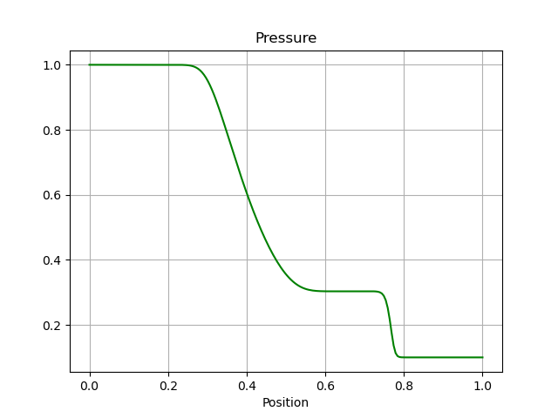
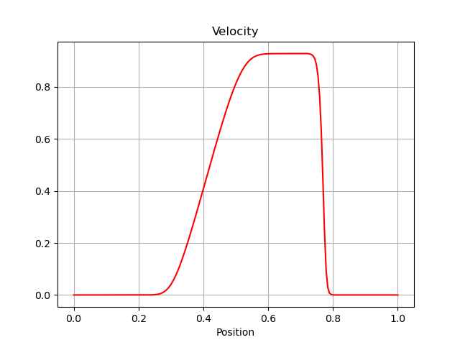
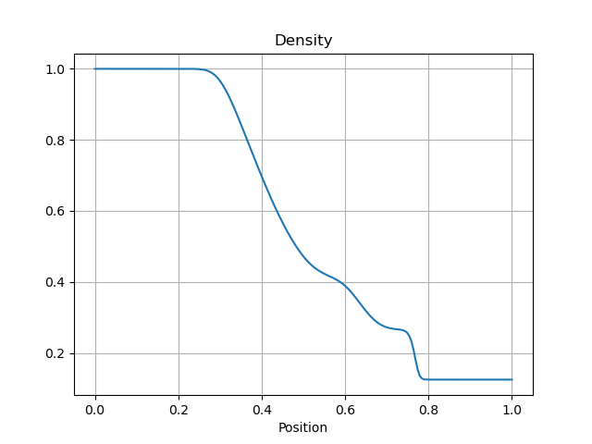
Results
Notes:
jimmy

Slide 11
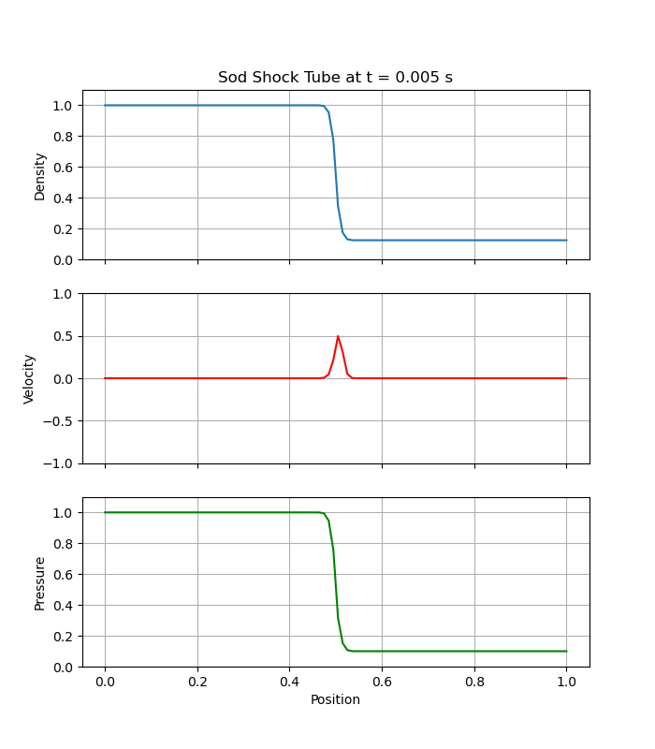
Results - GIF
Notes:
Jimmy

Slide 12
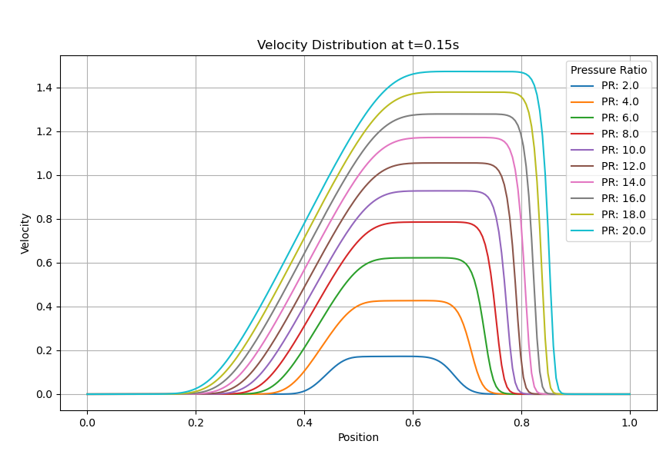
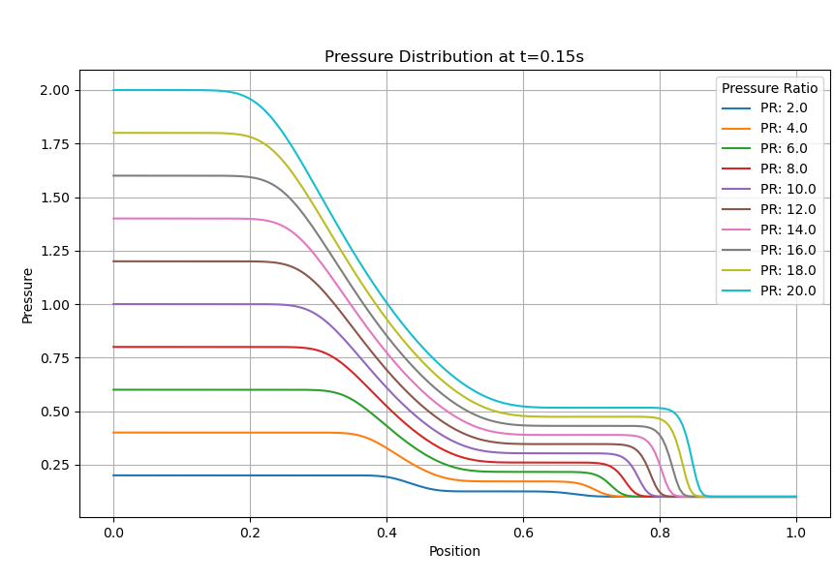
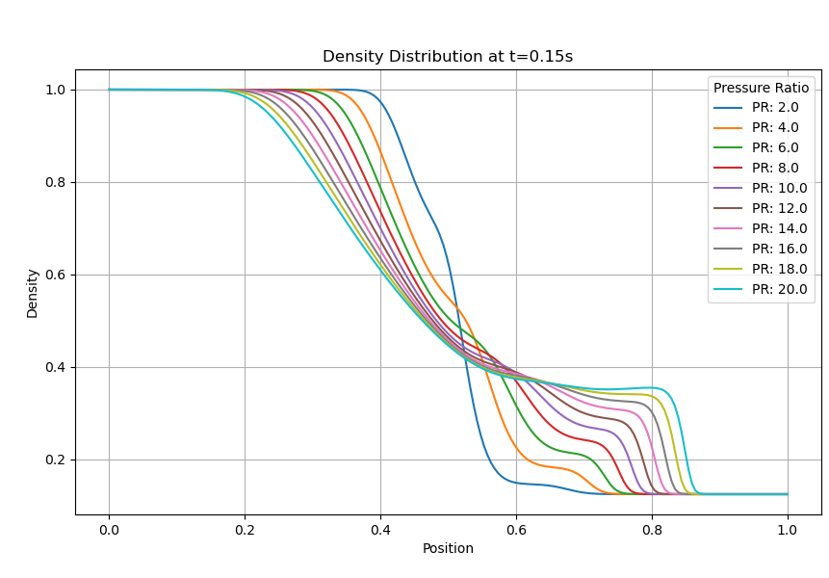
Parametric Sweep of Pressure Ratios
Notes:
Jack

Slide 13
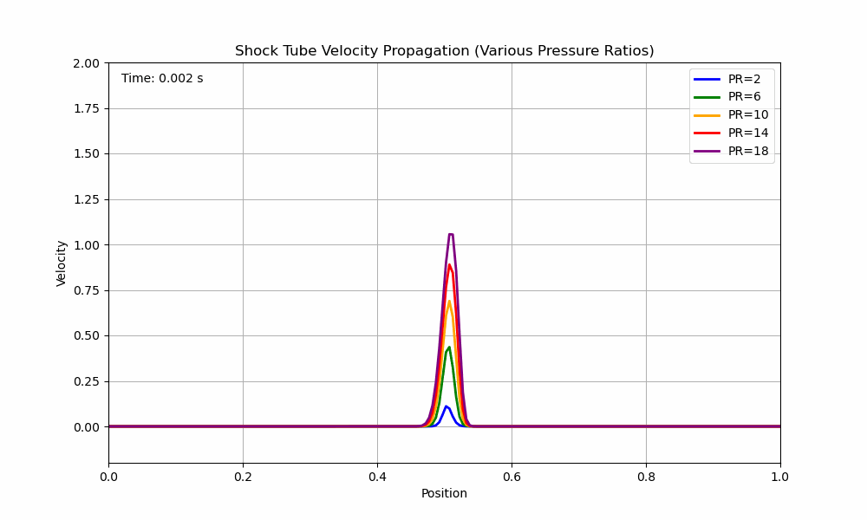
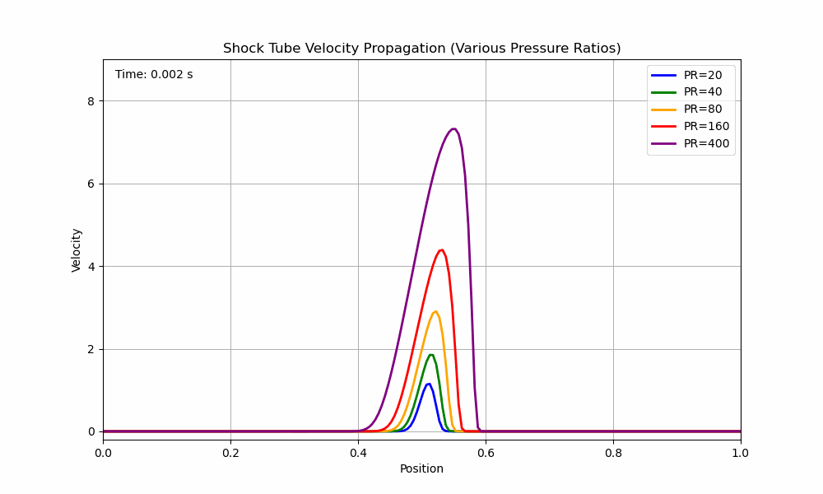
Parametric Sweep of Pressure Ratios - GIF
Notes:
Jack

Slide 14
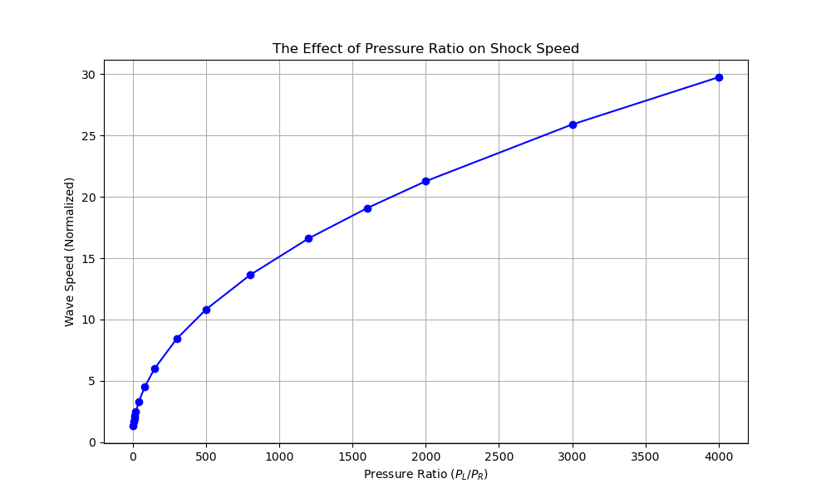
Pressure Ratio and Wave Speed
Notes:
Jack

Slide 15
Future Direction
More accurately simulate viscous effects.
Go from this:
To this:
Notes:
Nolan

Slide 16
References
“Anderson — Chapter 3: One-Dimensional Flow.” CFLOW Online Flow Calculator, compflow.onlineflowcalculator.com/Anderson/Chapter3/print/.
Compressible Flow
Sod, Gary A. “A Survey of Several Finite Difference Methods for Systems of Nonlinear Hyperbolic Conservation Laws.”
https://en.wikipedia.org/wiki/Space_Shuttle_Columbia_disaster
https://www.youtube.com/watch?v=F-zUswydGXw

Slide 17
Questions / Comments?

Slide 18
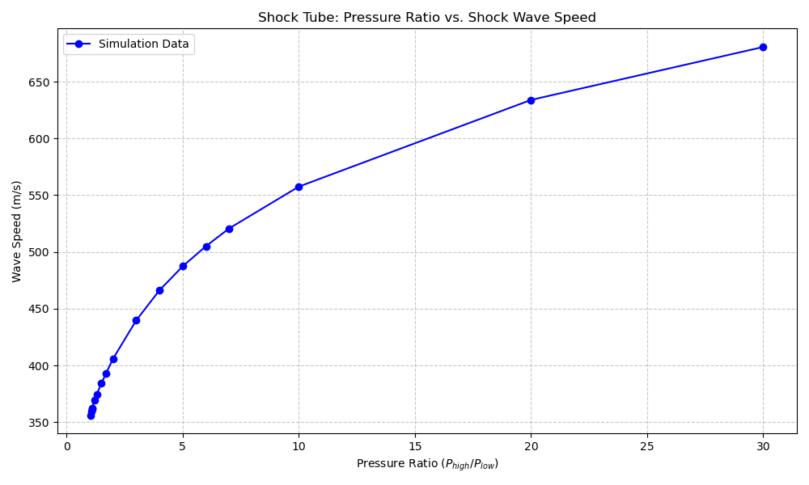
Pressure Ratio and Wave Speed (SI Units)
Initial Conditions:
P_driven = 100,000 Pa
Tube length = 4 m
Diaphragm location = 2 m
Density = P / RT
T = 293 K
Speed of sound at 293 K (isentropic):
c = 343 m/s
Speed at PR of 1.02: 343 m/s

Slide 19
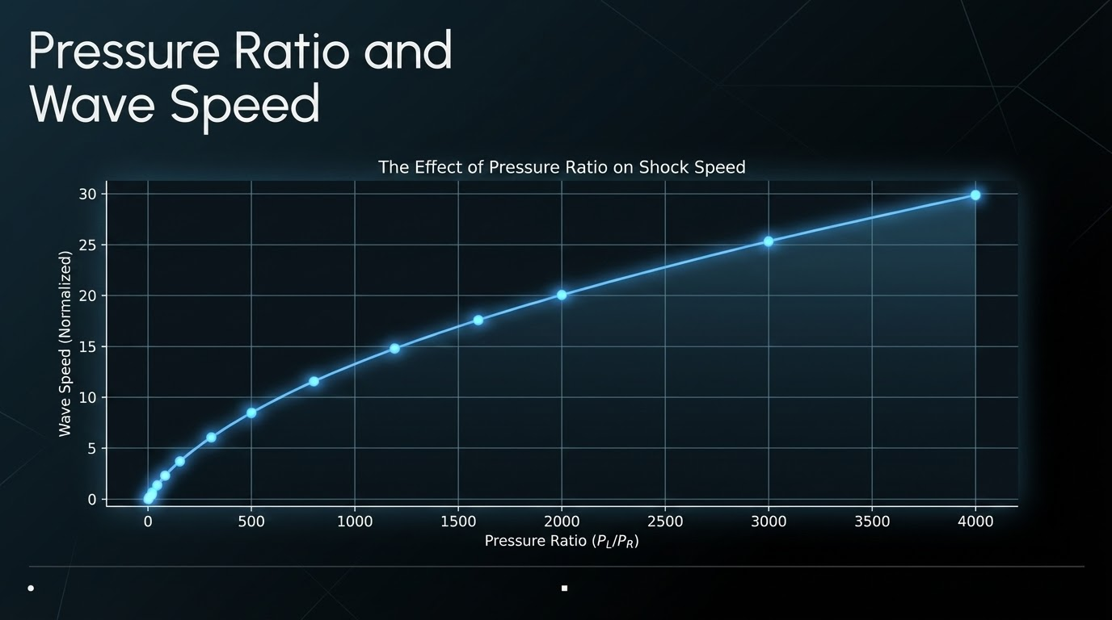

Slide 20
