Slide 1
Multiphysics Simulation of a Gas Turbine Blade
Nolan Chanda, Ethan Johnson, Jimmy Pare, Camden Piper

Slide 2
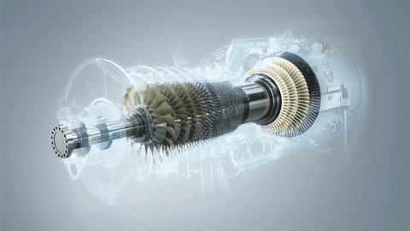
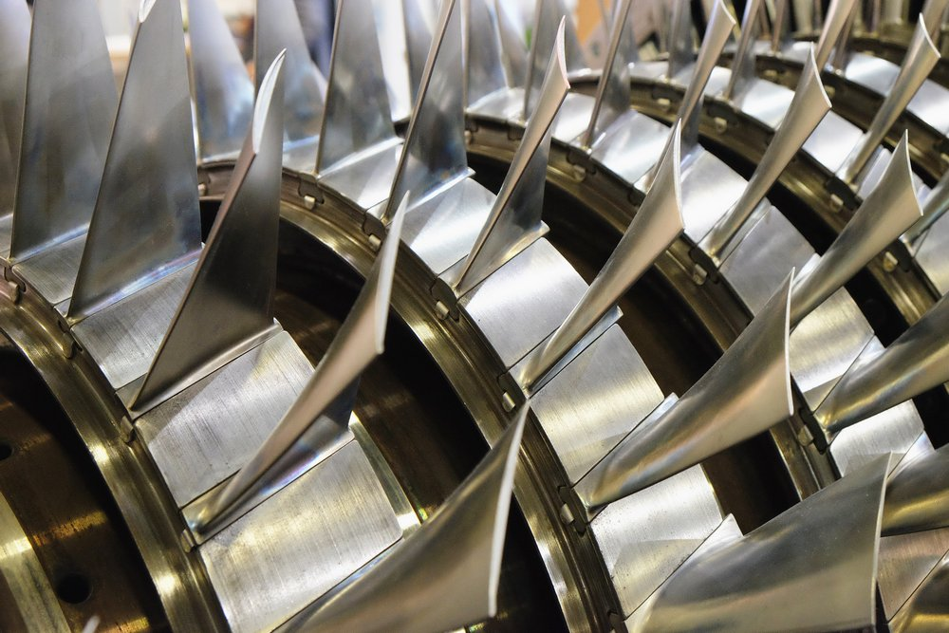
Motivation
Gas turbine blades must operate in extreme conditions.
Wide ranges of frequencies are seen.
Natural frequencies are of interest to prevent catastrophic failure at resonance points.

Slide 3
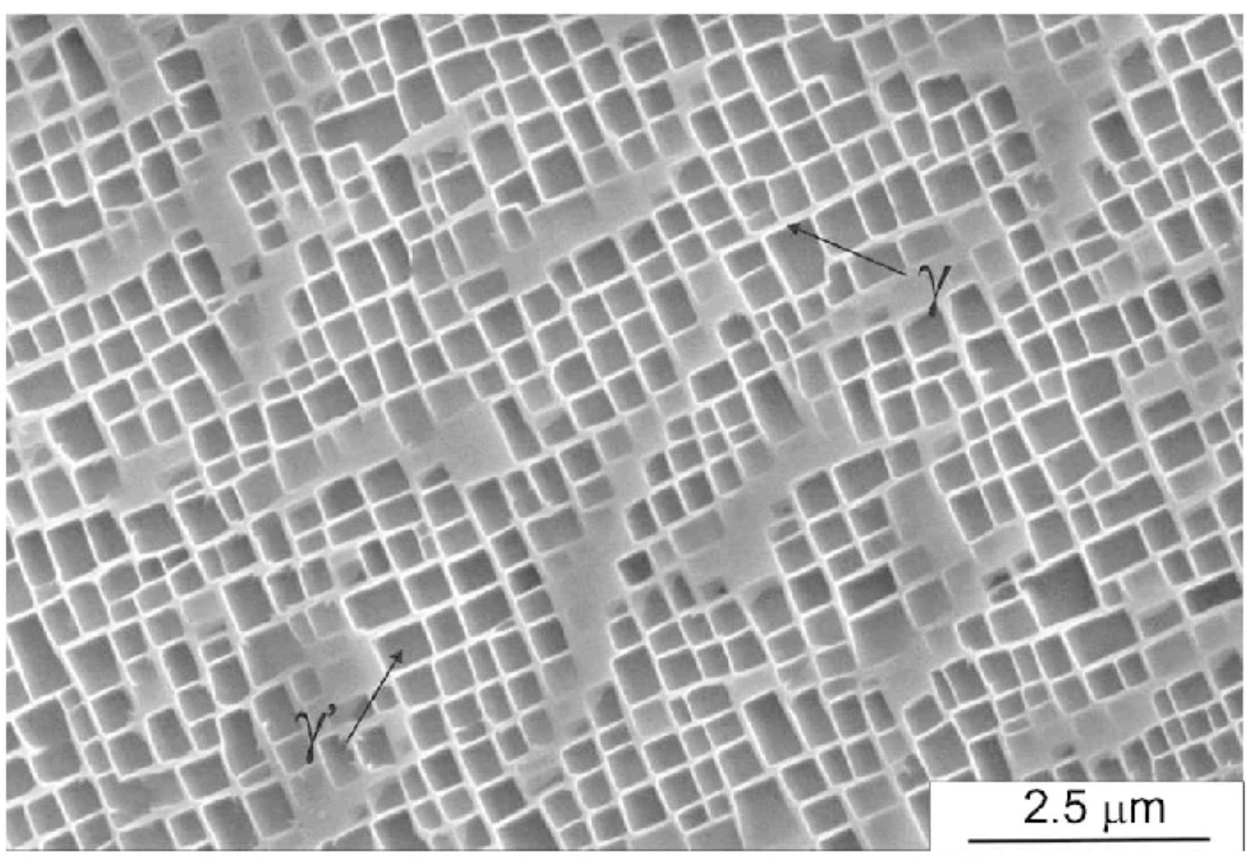
Background
Gas turbine blades are made of superalloys.
Superalloys withstand extreme temperatures and stresses.
Superalloys have anisotropic material properties and are not naturally occurring.
This study used CMSX-4, a single-crystal superalloy
Note: This pattern is the ɣ’ precipitate lattice, not grain boundaries.

Slide 4
Background
Initial conception and use
Advancing aerospace technology during WWII demanded gas turbine development.
80Ni-20Cr superalloy was typically used.
Modern use
Gas turbines are primarily used in aerospace and energy generation applications.
Various superalloys are used across applications, Nickel-based choices are common.

Slide 5
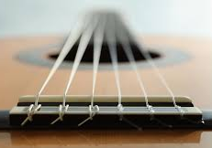
Centrifugal Stiffening: mode frequencies go up as RPM increases
As the centrifugal force increases, turbine blades get pulled tighter (25,000 - 30,000 lbs). This increases the natural frequencies of the system.
This affect must be accounted for with turbine design because the natural frequencies are no longer constant with RPM.
Similar to pulling a guitar string tighter which increases the tone.
https://www.stringsbymail.com/articles/guitar-strings-order-e-a-d-g-b-e-and-tuning-methods/

Slide 6
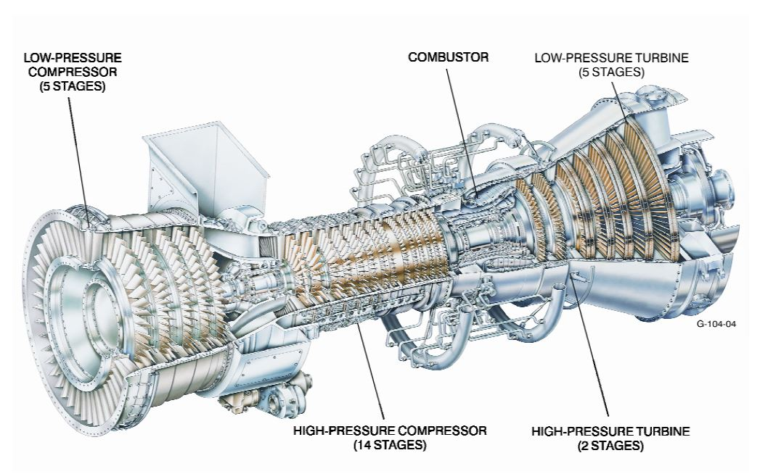
This study seeks to simulate a turbine blade after the combustion chamber of a turbine engine.
C3X blades in this region

Slide 7
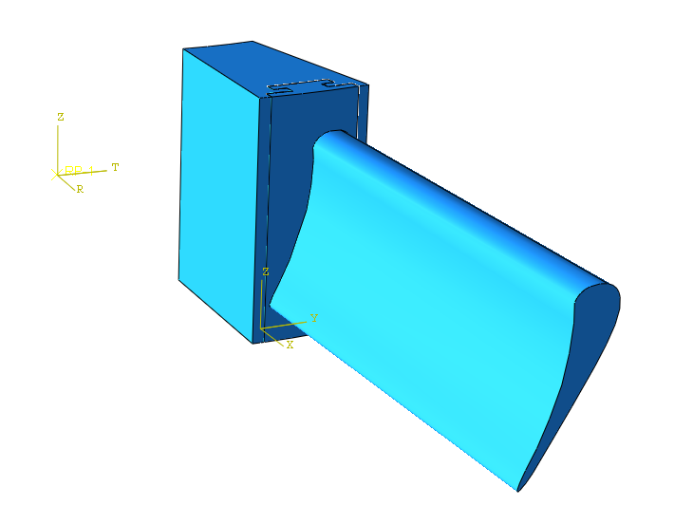
Geometry: C3X turbine blade.
Two parts were used that slide together to accurately model the interaction.
m = 4.49 kg for the blade assembly.
Blade radius of 0.2 m.
One blade of a 30 blade disk.

Slide 8
CMSX-4 Material Properties
Temperature (°C) | Thermal Expansion α (1/K) | Thermal Conductivity (W/m·K) | Specific Heat (J/kg·K)
20 | 1.25E-05 | 9.5 | 435
500 | 1.38E-05 | 14 | 520
900 | 1.55E-05 | 18 | 620
1100 | 1.65E-05 | 22 | 680
Density: 8700 kg/m^3

Slide 9
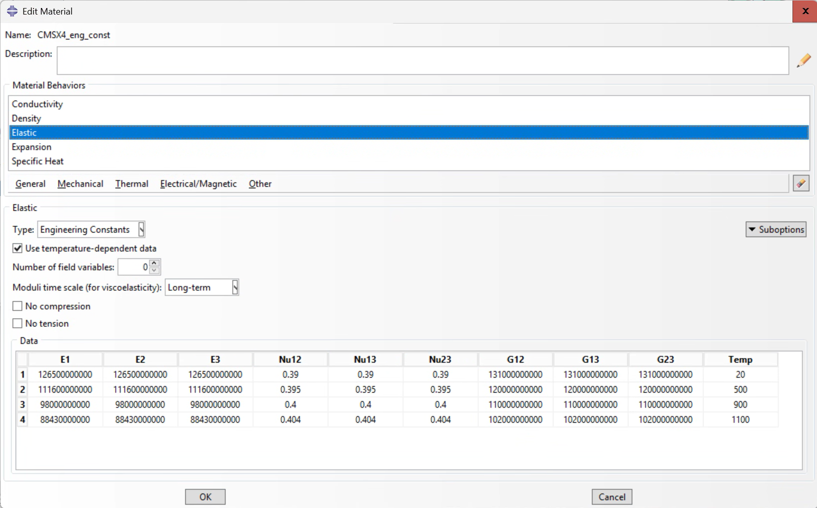
Anisotropic, temperature dependent material properties
Notes:
We originally tried fully anisotropic material properties that were temperature dependent, but had convergence issues and swapped to using engineering constants.
E1, E2, and E3 are the same, but this is an anisotropic material because the shear modulus, G, does not follow the normal isotropic relationship.

Slide 10
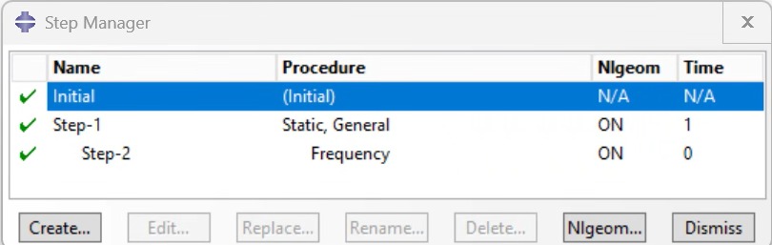
Steps
First a static loading step to preload and stiffen the blade, and then a frequency step.

Slide 11
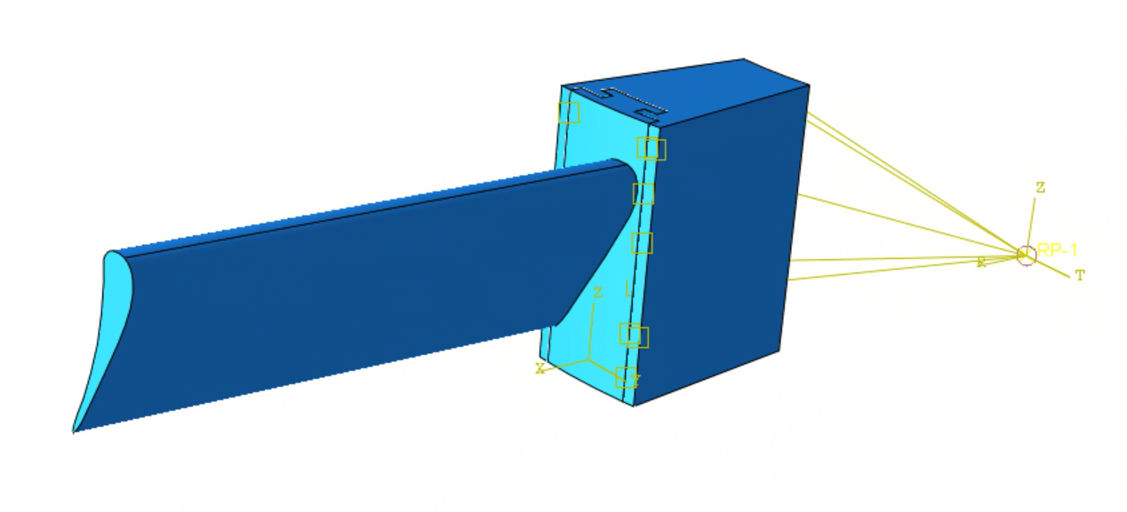
Interaction
Surface to surface hard contact, penalty of 0.3
Distributed coupling to RP at origin.

Slide 12
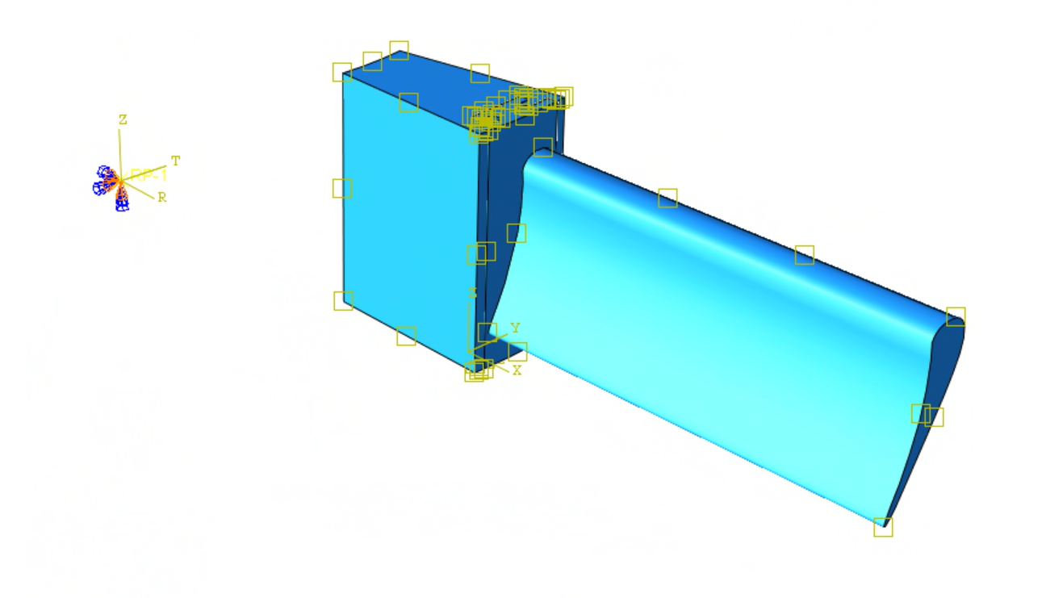
Loading Cases and BCs
 | RPM
Rest (off) | 0
Idle | 3,500
Cruise | 10,500
Max Power | 13,500
Overspeed | 15,000
Temperature [C]
38
200
550
750
850
Encastre RP at origin.
Rotational body force applied to whole assembly
Displacement in theta direction = 0 to simulate cyclic symmetry

Slide 13
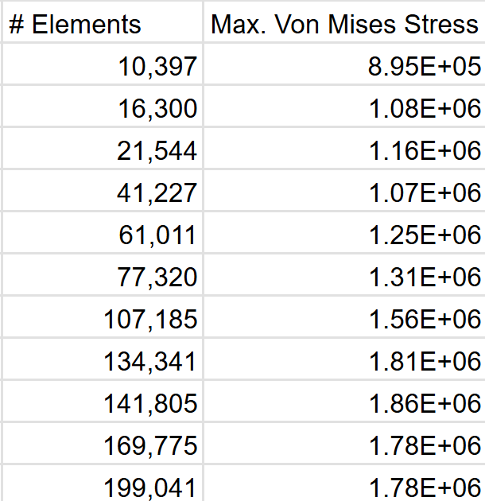
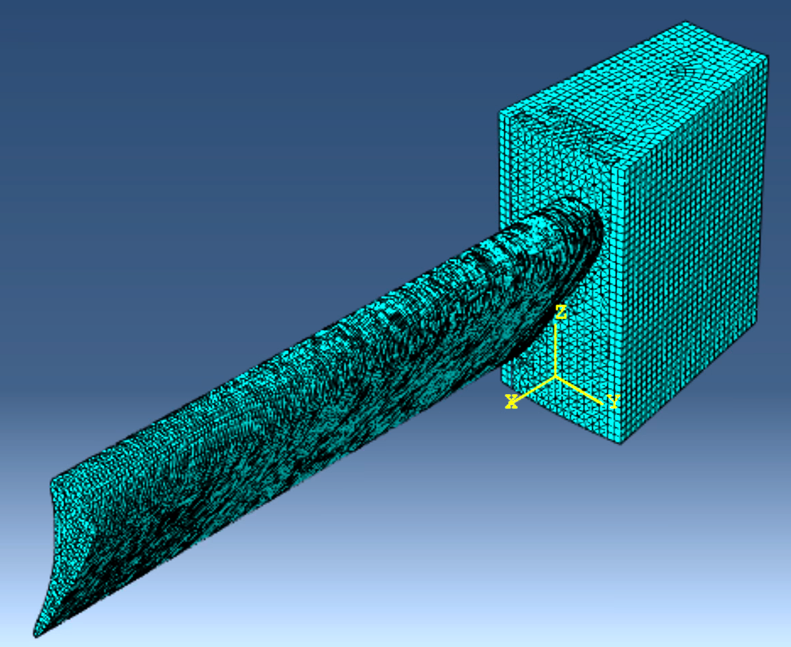
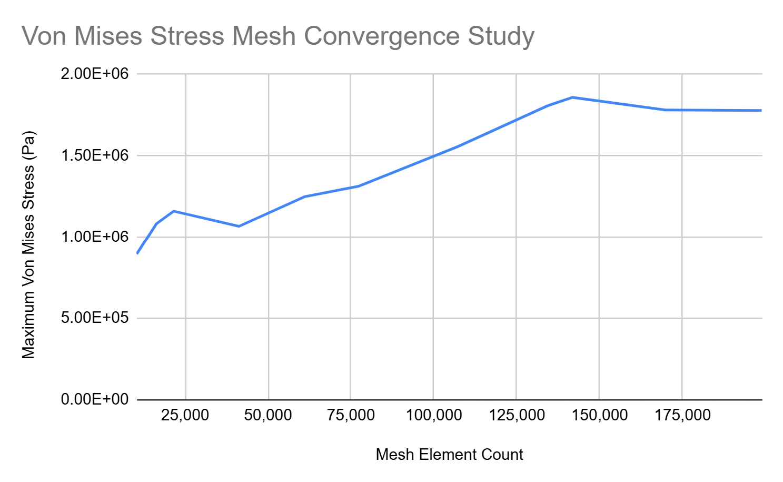
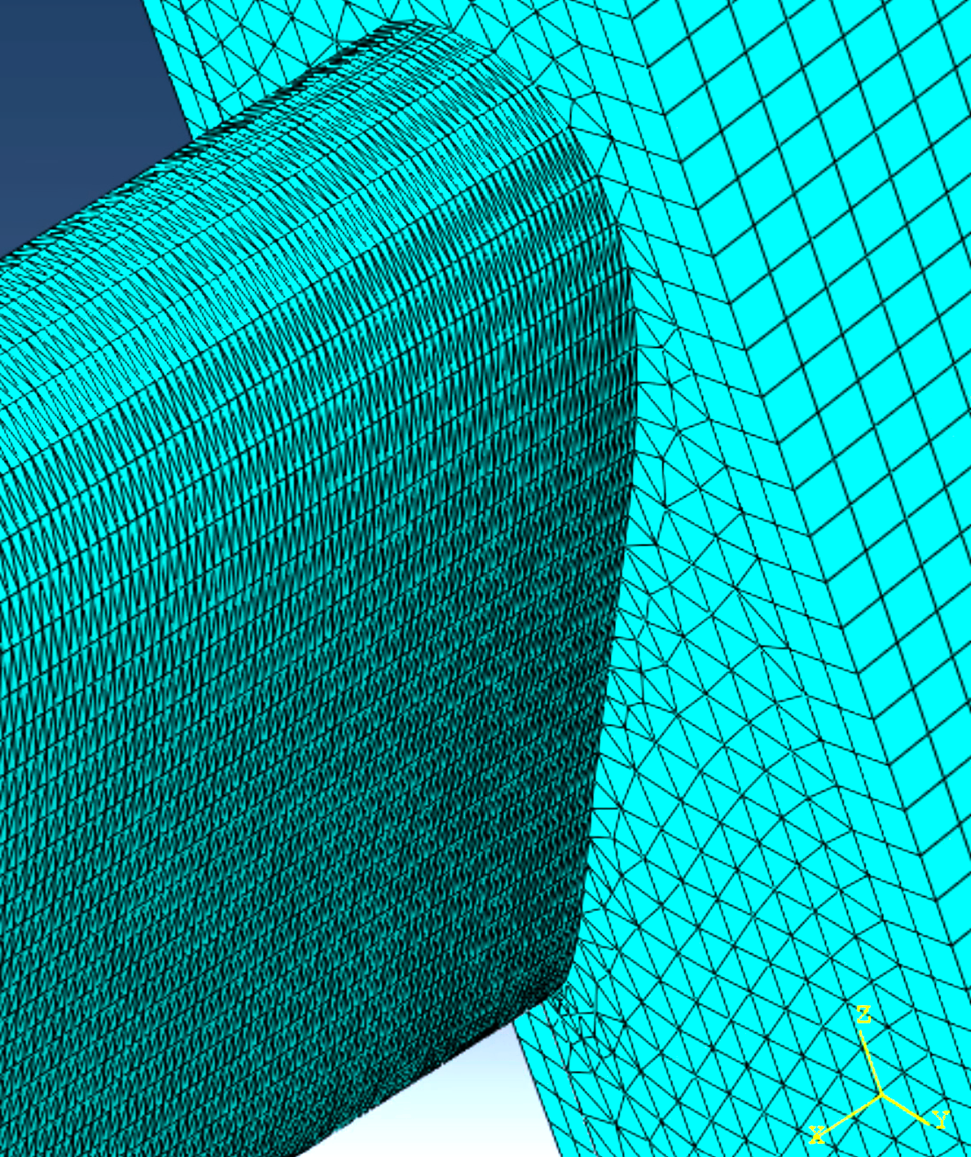
Mesh Convergence
Converged Mesh

Slide 14
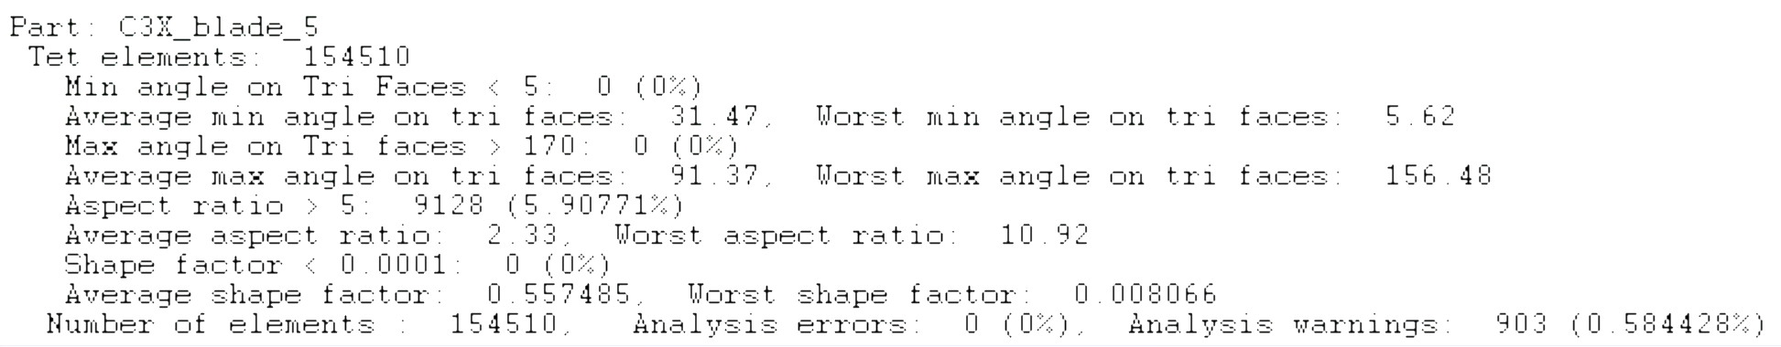
Mesh Quality
Constrained by mesh element cap for license

Slide 15
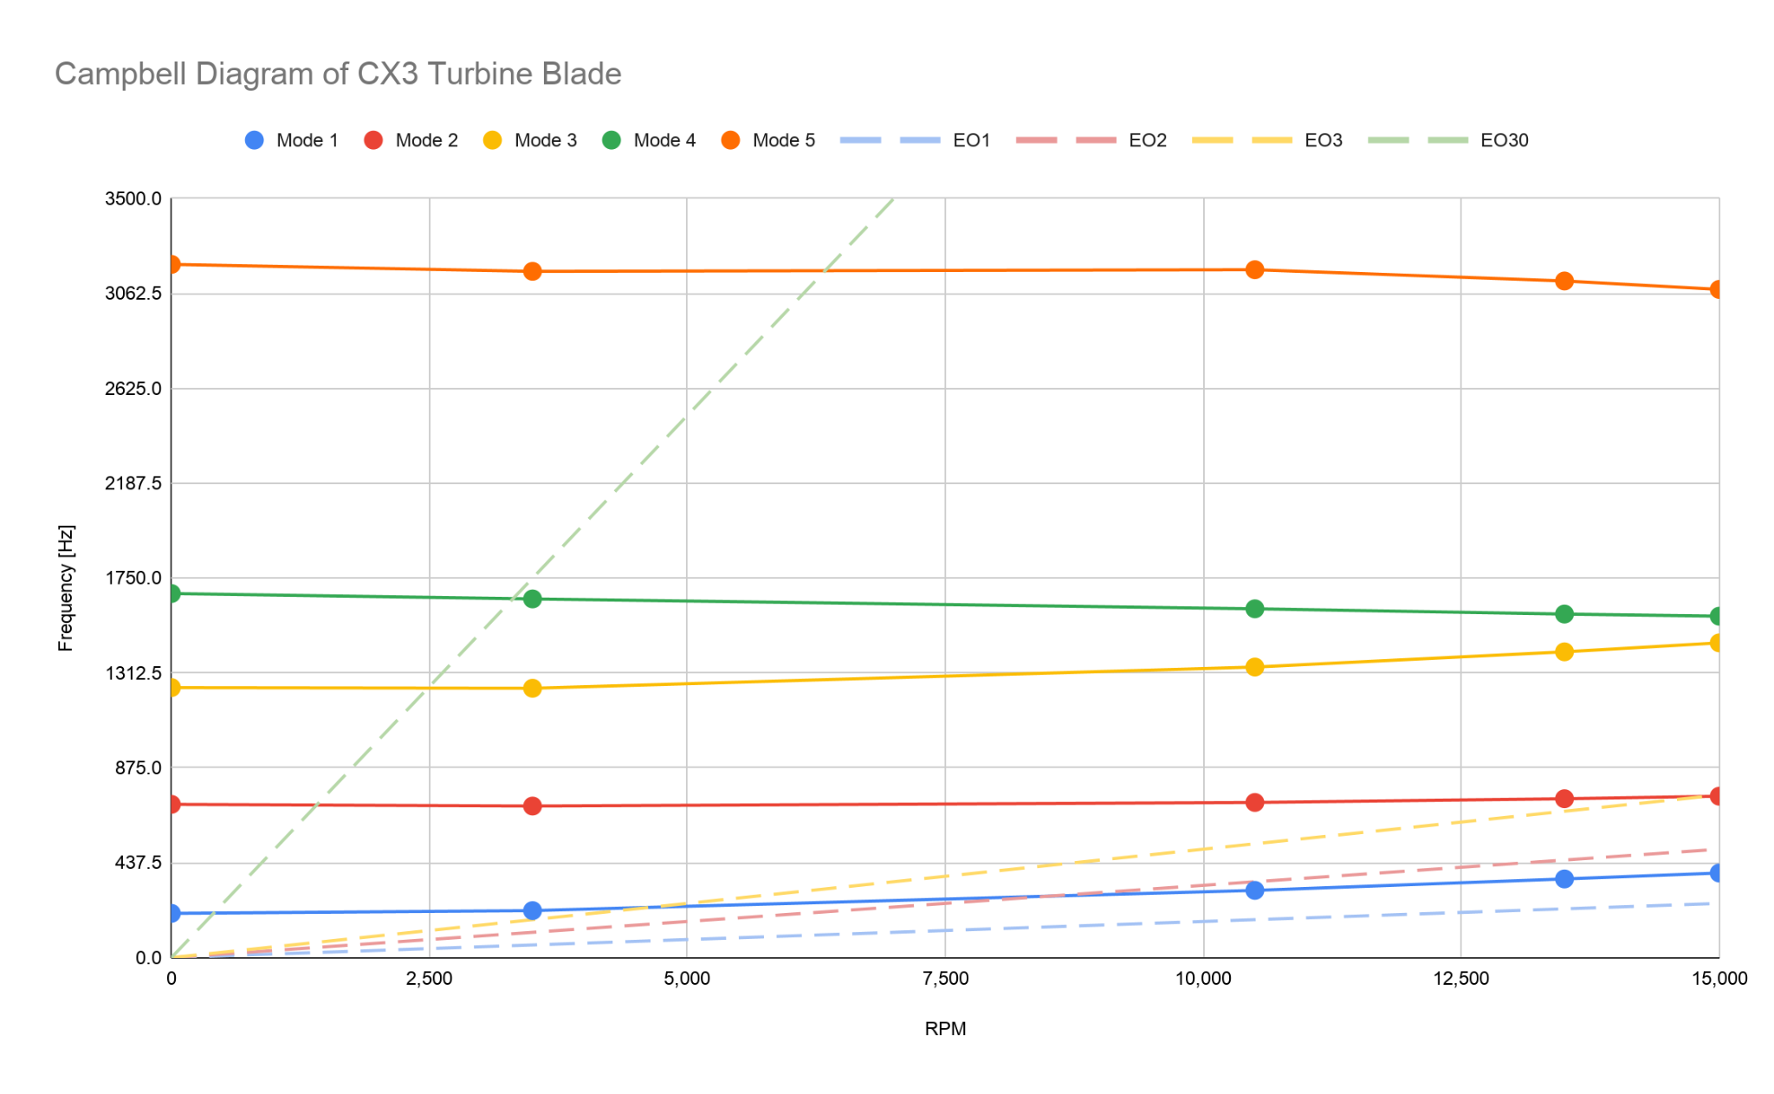
High risk of resonance at these intersection points
Notes:
We see centrifugal stiffening for some modes of vibration, but we also observe the natural frequencies decreasing with higher modes. This is different from when we ran the simulation with isotropic material properties, where all modes showed centrifugal stiffening.
EO = Engine Order, which is basically the frequency that the turbine blade may feel. For example, an engine order of 30 could represent the turbine blade feeling 30 ‘puffs’ of air per second as the 30 blade disk spins behind another set of blades.

Slide 16
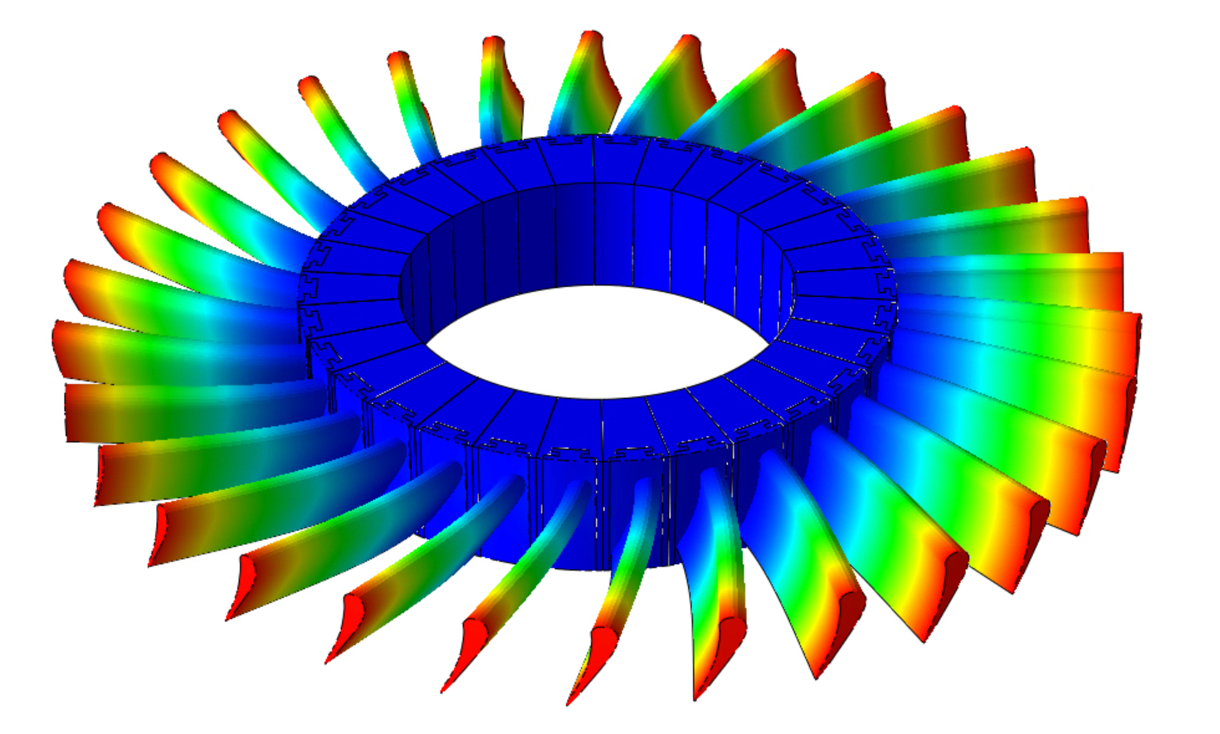
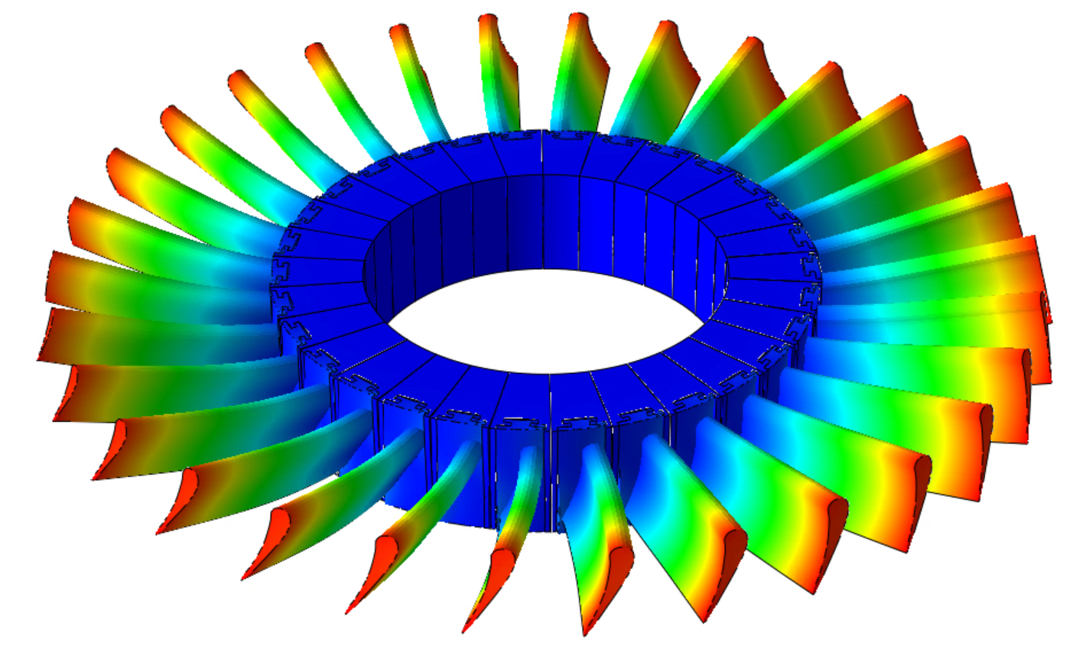
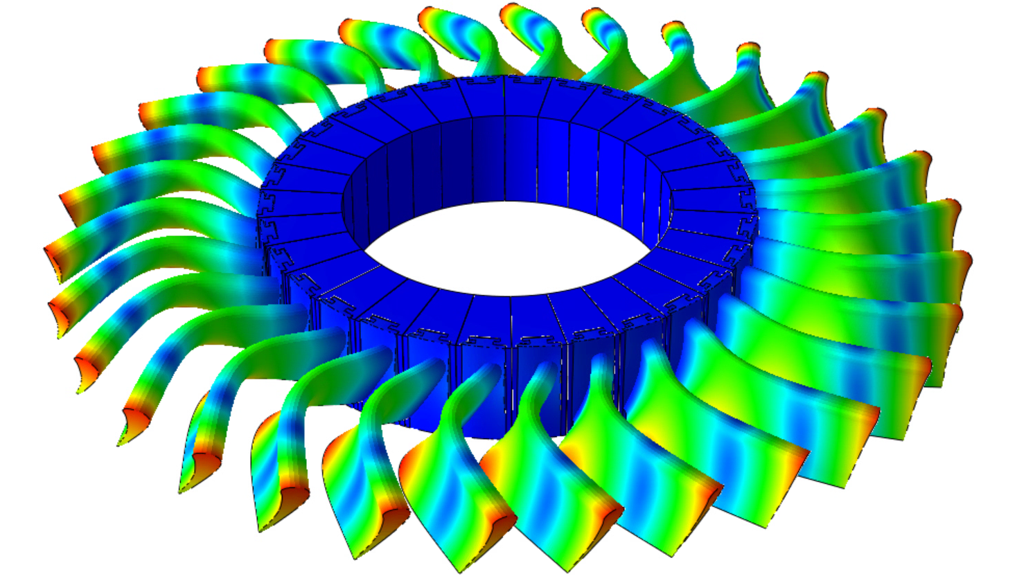
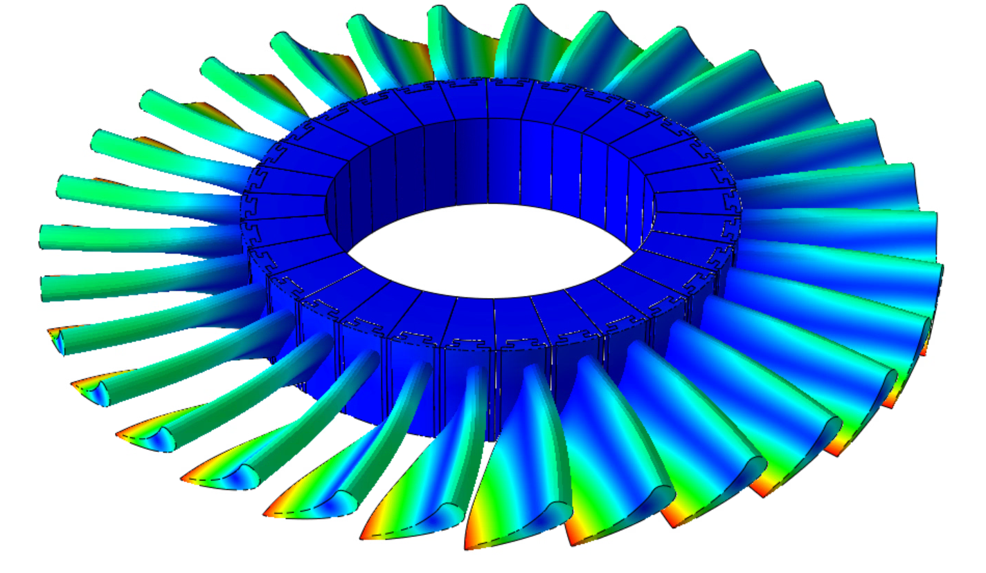
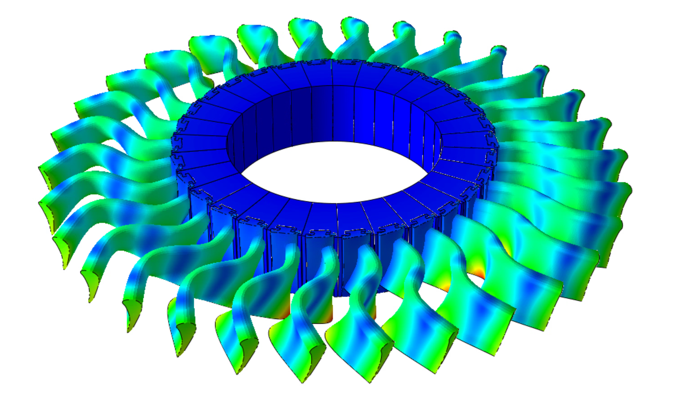
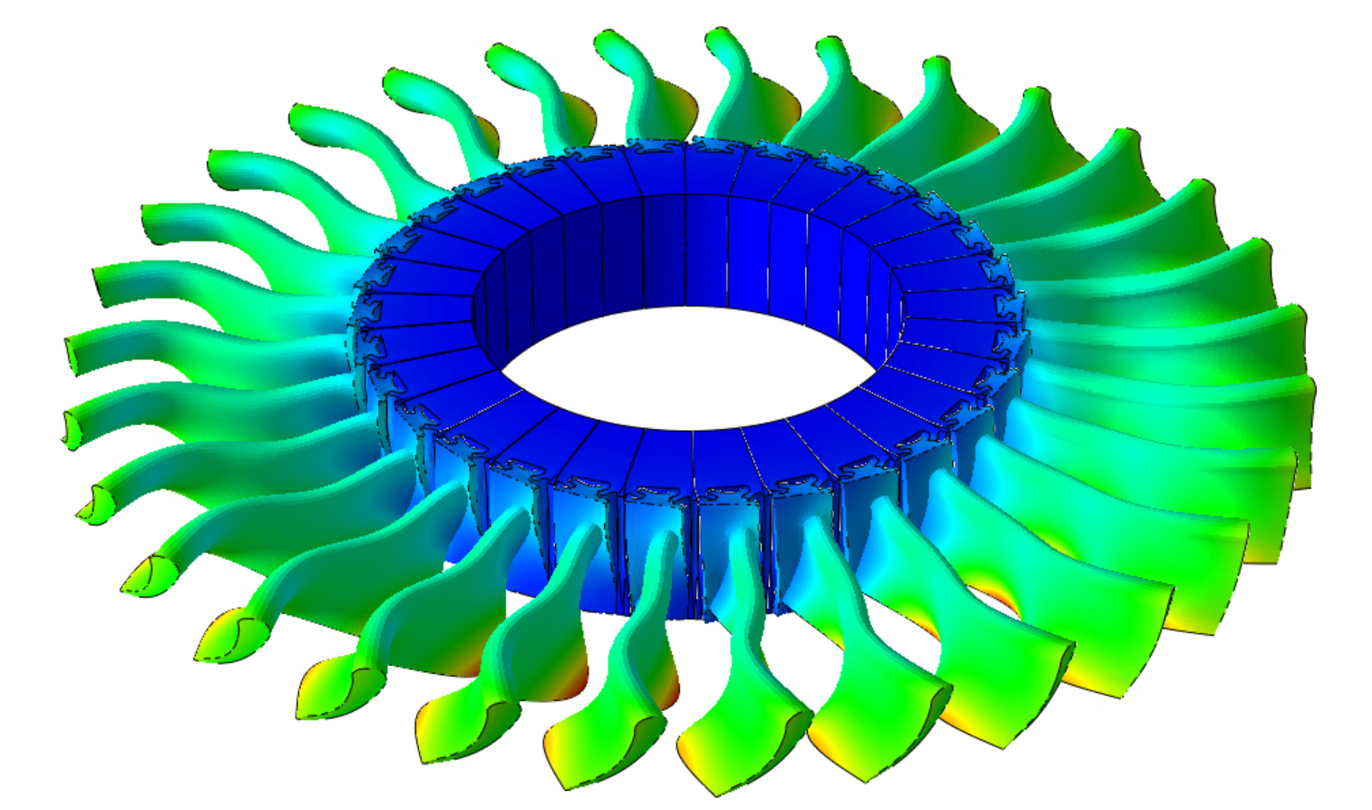
Results - Displacement Contour Plots of Modes
f1
f2
f3
f4
f5
f6
Note: legend intentionally left out because displacement is normalized. How the blade moves is accurate, how much it moves is not.

Slide 17
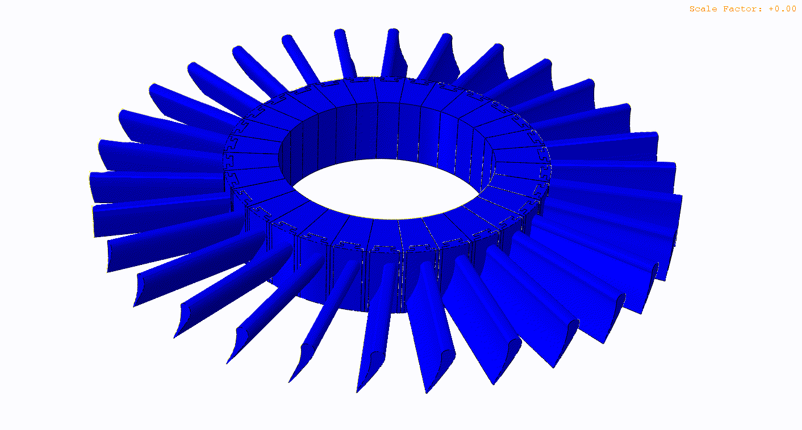
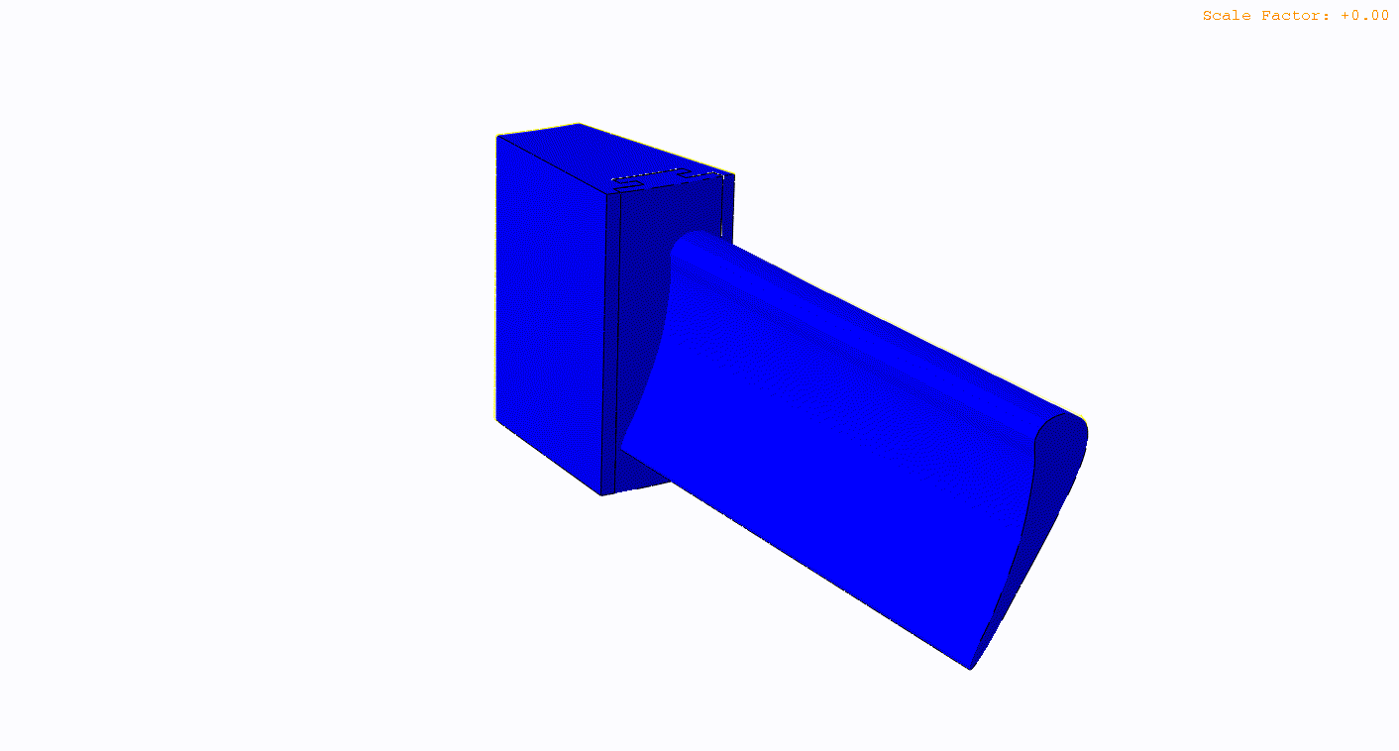
Results - Animation of f1 at rest

Slide 18


Results - Animation of f4 at rest

Slide 19
Conclusions and Recommendations
Approximate resonant speeds
400 RPM
1,500 RPM
2,500 RPM
3,250 RPM
4,800 RPM
6,300 RPM
8,500 RPM
14,900 RPM
Since cruise speed is around 10,500 elements, low risk of failure during operation.
Future studies
Coupled structural-fluid study to capture turbulent flow exchange.
Complete anisotropic material properties.
Change interactions to model realistic stiffness/rigidity.
Higher quality mesh to capture stress concentrations.

Slide 20
Thank you
Questions?

